Slide 1
Proof Techniques

Slide 2
PROOF BY CONTRADICTION
steps:
Assume p∧¬q is true
Try to solve that the above assumption (p∧¬q) is false.
When the assumption is found to be false then implication
p → q is true.
Since p → q is equivalent to ¬ p ∨ q and the negation of ¬ p ∨ q is p∧¬q(by de morgan’s law), so if our assumption is false then its negation is true.
Proofs of this type are called proofs by contradiction. Because a proof by contradiction does not prove a result directly, it is another type of indirect proof.

Slide 3
EXAMPLE
Give a proof by contradiction of the theorem “If 3n + 2 is odd, then n is odd.”
Solution:
Let p be “3n + 2 is odd” and q be “n is odd.” To construct a proof by contradiction, assume that both p and ¬q are true. That is, assume that 3n + 2 is odd and that n is not odd.
Because n is not odd, we know that it is even. Because n is even, there is an integer k such that n = 2k. This implies that 3n + 2 = 3(2k) + 2 = 6k + 2 = 2(3k + 1). Because 3n + 2 is 2t , where t = 3k + 1, 3n + 2 is even.
Note that the statement “3n + 2 is even” is equivalent to the statement ¬p, because an integer is even if and only if it is not odd. Because both p and ¬p are true, we have a contradiction.
This completes the proof by contradiction, proving that if 3n + 2 is odd, then n is odd.

Slide 4
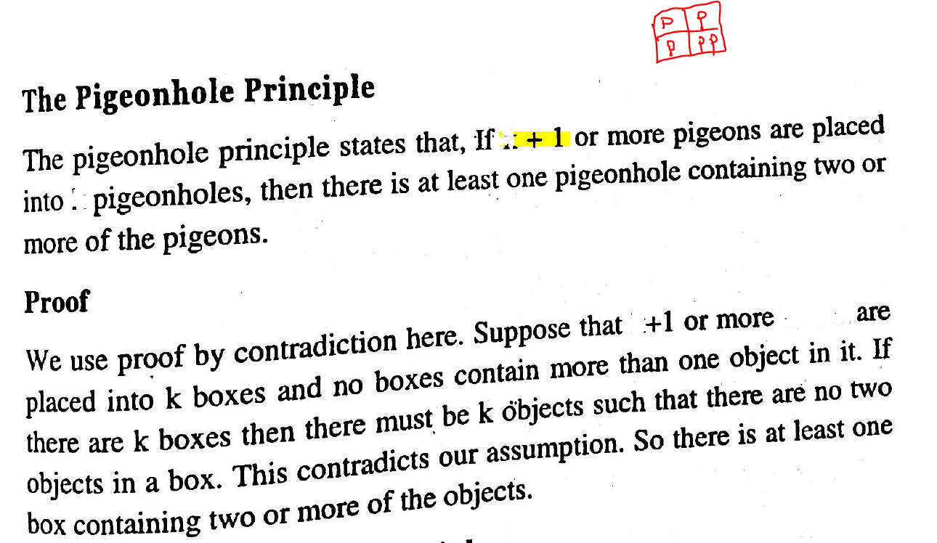
5 pigeons
4 holes
n
n
n
objects
n
n
n

Slide 5
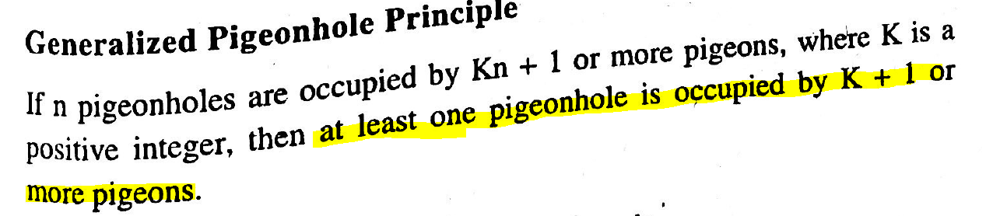
Notes:
21 pigeons and 4 holes example

Slide 6
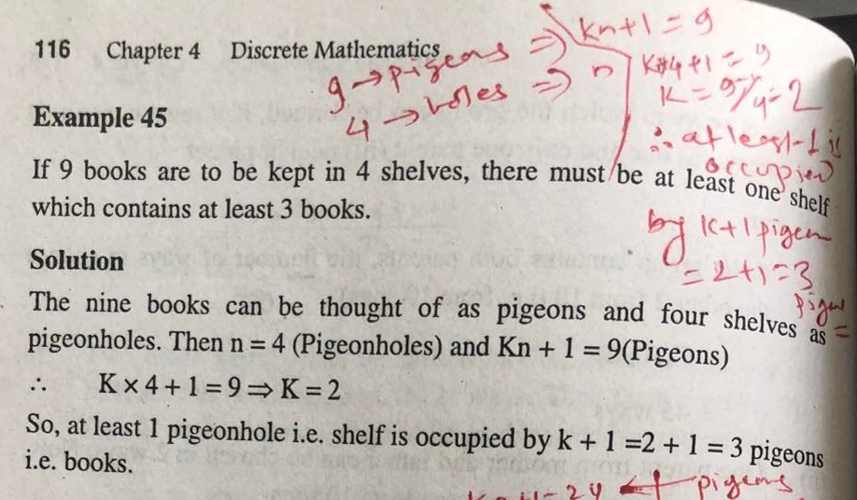

Slide 7
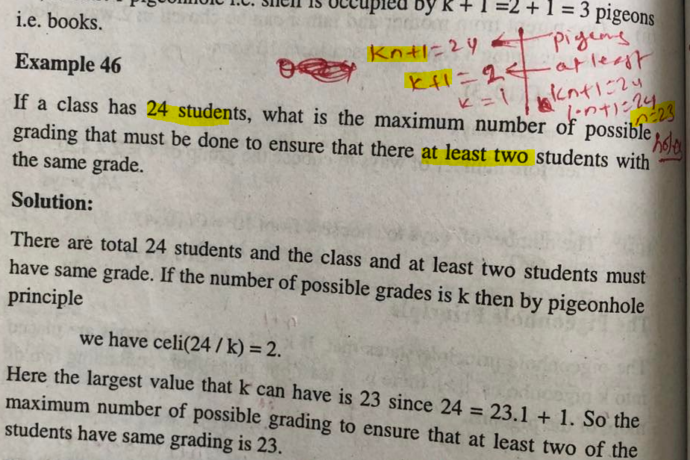

Slide 8
